Slide 1
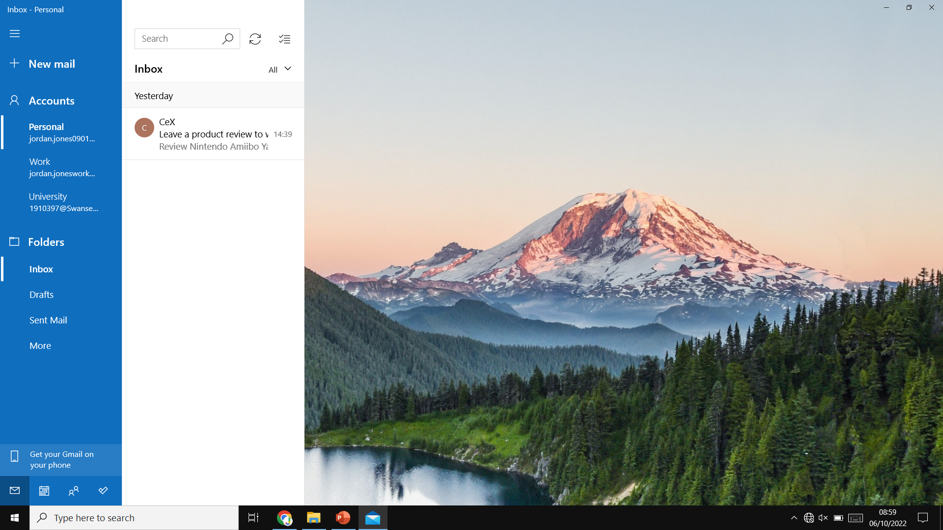
Introduction Screen
Accounts
Pers|
jordan.jones090…
Change Nickname
Logout
Work
jordan.joneswor…
University
1910397@swan…
University
1910397@swan…
School
jordan.jones12…
+ Login
Options
+ Create
Inbox
Drafts
Sent
Spam
Bin
Work
jordan.joneswor…

Slide 2
Login Screen
Accounts
Personal
jordan.jones090…
Email Address
Work
jordan.joneswor…
Password
Might Require an App-Specific Password for the given Email Account Provider
University
1910397@swan…
University
1910397@swan…
Show Password
School
jordan.jones12…
Login
+ Login
Options
+ Create
Inbox
Drafts
Sent
Spam
Bin

Slide 3
Create/Edit Screen
Accounts
Recipients (Split between a comma [,])
Personal
jordan.jones090…
Carbon Copies
Work
jordan.joneswor…
Blind Carbon Copies
Subject
University
1910397@swan…
University
1910397@swan…
<!Tag Name!>
Tags
School
jordan.jones12…
+
+ (List)
Tag Name
>
+ Login
+
X
Options
+ Create
Inbox
Drafts
Sent
Spam
Bin
Tag Name (List)
>
+
X
•
Work
jordan.joneswor…
>
>
>
S_{s}
S^{s}
U
>
>
Arial
12
B
I
S
•
1.
Error!!!
Select Attachment File(s)
image.png
X
>
Send
music.mp3
X
>
Draft

Slide 4
Tags Screen
Accounts
>
jordan.jones090101@gmail.com
Personal
jordan.jones090…
Tag Name
Work
jordan.joneswor…
Tag Name (List)
<
X
+
University
1910397@swan…
University
1910397@swan…
<
<
X
School
jordan.jones12…
<
X
+ Login
Error!!!
Options
+ Create
Inbox
Drafts
Sent
Spam
Bin
Send
Cancel

